Slide 1

DESIGN GOALS
CHAPTER 08
‹#›

Slide 2
Topics
Designer-Centric Goals
Goals centered around what you want for yourself as a deisgner
Player-Centric Goals
Goals centered around what you want for your players
‹#›

Slide 3
Designer-Centric Goals
Fortune – You want to make money
Fame – You want people to know who you are
Community – You want to be part of something
Personal expression – You want to communicate with others through games
Greater good – You want to make the world better in some way
Becoming a better designer – You simply want to make games and improve your craft
‹#›

Slide 4
Designer-Centric Goals: Fortune
"You can literally make hundreds of ...dollars in the game industry."
– John "Chow" Chowanec
There are a lot of easier ways to make money
As a programmer, banks will happily pay you a LOT
All entertainment jobs generally pay less for the same work
Very few people in the industry hit the jackpot
The chance of an individual small game making lots of money (like Flappy Bird or Minecraft) is very small
However, you can make a decent living
This is especially true if you work for a large studio
‹#›

Slide 5
Designer-Centric Goals: Fame
Very few people become famous as game designers
Many of the names you know have been designers for decades
Will Wright, Sid Meier, John Romero, etc.
There are some new designers who are well-known
Jenova Chen, Jonathan Blow, Markus "Notch" Persson
But their games are much more famous than they are
Flow / Flower / Journey, Braid, and Minecraft respectively
I believe that Community is a better (and much more attainable) goal than Fame
‹#›

Slide 6
Designer-Centric Goals: Community
There are many different communities in game dev
As a whole, the industry is surprisingly small
You will get to know and meet a lot of people
The game dev community is much more welcoming & diverse than some AAA games would make it seem
There are many sub-communities of developers working to make games from varied perspectives
IndieCade and other game conferences have hosted several well-attended diversity panels and workshops
The indie game scene, in particular is a meritocracy
If you make great work, you will be respected
‹#›

Slide 7
Designer-Centric Goals: Personal Expression and Communication
You wish to make a statement through your game
But statements can be made through any medium
Ask these two questions to determine whether interactive media is the right medium for you:
What form of media could best express this concept?
What forms of media are you adept at using?
There is a growing audience for these pieces
Several personal expression games have received critical acclaim (and some have even seen commercial success)
That Dragon, Cancer - Ryan Green and Josh Larson (2014)
Mainichi - Mattie Brice (2013)
Papo y Yo - Minority Media (2014)
‹#›

Slide 8
Designer-Centric Goals: Greater Good
A number of people make games because they want to make the world a better place
There are many names for these games:
Serious Games
The oldest and most general term
These are still fun, they just have a serious purpose
One very important category is Educational Games
Games for Social Change
Games that are meant to influence or inform people about a topic
Example topics: Climate change, Politics, etc.
Games for Behavioral Change
Games that seek to change a players behavior outside of the game
Examples: Exercise games, Games about nutrition, etc.
‹#›

Slide 9
Designer-Centric Goals: Becoming
a Better Designer
The #1 way to become a better designer is to make a lot of games
The purpose of this book is to help you get started doing so
Every game you make will improve your skills as a designer
Even bad games!
You won't know if a game concept is good or bad until you implement it
‹#›

Slide 10
Player-Centric Goals
Fun – Players enjoy themselves
Lusory Attitude – Players to get into a gamer's mindset
Flow – Players are optimally challenged
Structured Conflict – Players experience challenge and competition in a structured way
Empowerment – Players feel powerful
Attention and Involvement – Players are engaged by your game in a sustained way
Interesting Decisions – Players have tough choices
Experiential Understanding – Players gain new understanding through interactive experiences
‹#›

Slide 11
Player-Centric Goals: Fun
Fun is, of course, not the only goal of a game
Players are willing to play something that isn't "fun" as long as it holds their attention
In Game Design Theory, Keith Burgun proposes three aspects that make a game fun:
Enjoyable
Engaging
Fulfilling
‹#›

Slide 12
Player-Centric Goals: Fun
Enjoyable
Enjoyment is what most players are seeking in a game
In Les Jeux et Hommes (Man, Play, and Games), Roger Caillois identified four types of play:
Agon - Competitive play (e.g., chess, baseball, Uncharted)
Alea - Chance-based play (e.g., gambling and rock, paper, scissors)
Ilinx - Vertiginous play (e.g., roller coasters, children spinning around until they're dizzy, and other play that makes the player feel vertigo)
Mimicry - Play centered on make-believe and simulation (e.g., playing house, playing with action figures).
Each of these are enjoyable in their own way
‹#›

Slide 13
Player-Centric Goals: Fun
Engaging
The game must grab and hold the player's attention
This is discussed in detail in the following Attention and Involvement section
Fulfilling
Playing the game should fulfill some desire of the player
Socialization - Can be fulfilled by playing a board game with friends or by playing in the virtual community of Animal Crossing
Fiero (personal triumph over adversity) - Can be fulfilled by helping your team win a soccer match or defeating someone in Tekken
Or any of several other player desires
Different players have different needs
The same player can have different needs from day to day
‹#›

Slide 14
Player-Centric Goals: Lusory Attitude
In The Grasshopper, Bernard Suits states that a player must adopt a lusory attitude to play a game
Ludus is the Latin word for play
With a lusory attitude, a player will happily follow the rules of the game for the joy of eventually winning the game by following the rules (and not cheating)
In Imaginary Games, Chris Bateman points out that in games of ilinx, a lusory attitude is responsible for the distinction between excitement and fear
The lusory attitude forms the magic circle of the game
To maintain a lusory attitude, show respect for your players
‹#›

Slide 15
Player-Centric Goals: Flow
According to psychologist Mihaly Csíkszentmihályi, flow is the state of optimal challenge
In a flow state, a player is focused intently on the challenge before her and very often loses awareness of things that are outside of the flow experience.
This was the topic of Jenova Chen's MFA thesis paper at the University of Southern California
He adapted Csíkszentmihályi's theories to game design
His original Flow game can be played here:
http://interactive.usc.edu/projects/cloud/flowing/
‹#›

Slide 16
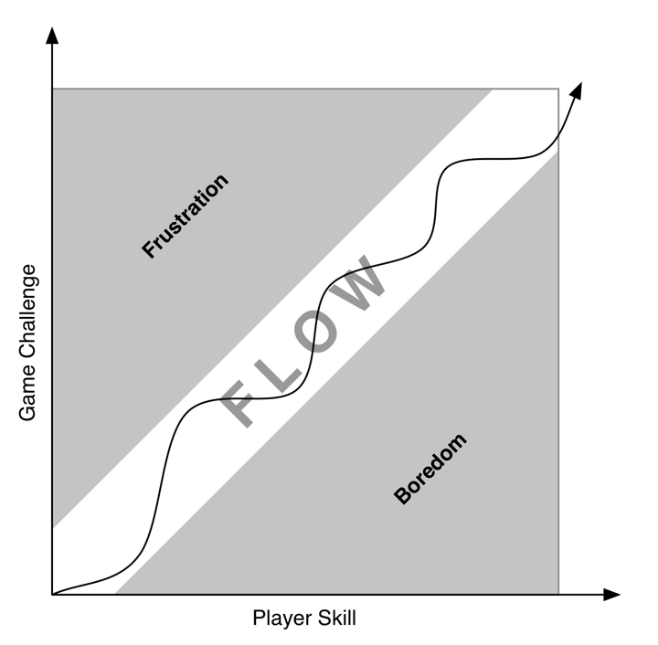
Player-Centric Goals: Flow
Flow is the channel between frustration and boredom
If the player is too skillful for the challenge, she gets bored
If the challenge is too high for the player, she gets frustrated
‹#›

Slide 17
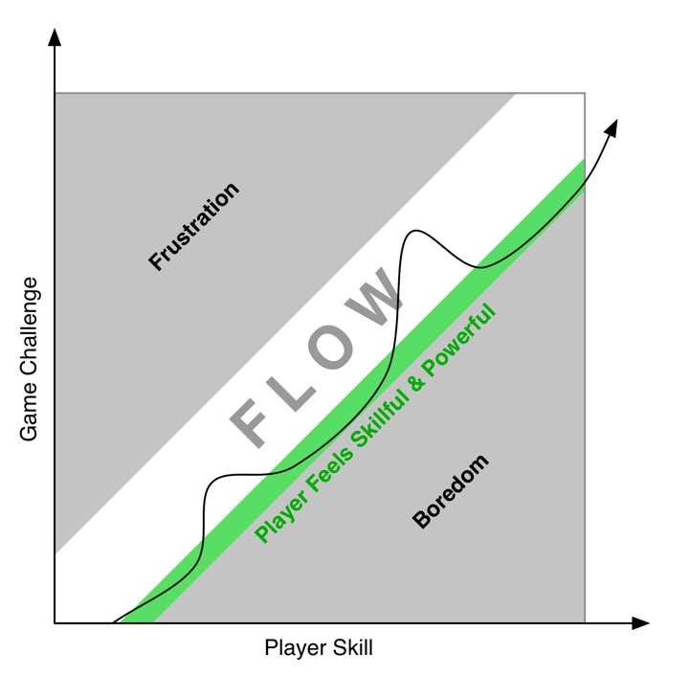
Player-Centric Goals: Flow
But, optimal challenge is exhausting after 20 minutes
It's often better to give the player breaks in flow
‹#›

Slide 18
Player-Centric Goals: Structured Conflict
According to Mary Midgely's paper "The Game Game," humans have a desire for structured conflict
"The Chess Player's desire is not for general abstract intellectual activity, curbed and frustrated by a particular set of rules. It is a desire for a particular kind of intellectual activity, whose channel is the rules of chess."
Chris Bateman finds this to be a desire in animals as well
"When our puppy plays with other dogs, there are clear limits as to what is acceptable behavior."
Many popular games are structured team conflict
Traditional sports (soccer, football, basketball, & hockey)
Online team games (League of Legends, Team Fortress 2, and Counter Strike)
‹#›

Slide 19
Player-Centric Goals: Empowerment
Flow is about making the player feel powerful in the game world
In contrast, this Empowerment gives the player power over what she chooses to do in the game
This is important in two senses:
Autotelic - The player forms her own goals
Performative - The player plays the game like an instrument
‹#›

Slide 20
Player-Centric Goals: Empowerment
Autotelic - The player forms her own goals
From the Latin for self (auto) and goal (telos)
Csíkszentmihályi believes that it is an autotelic personality that enables a person to find happiness in life regardless of situation.
Minecraft is an excellent example of a game that promotes autotelic behavior
Once players figure out how to survive, the rest of the game is about their personal choices of what to do
More mainstream games like Dishonored and Splinter Cell also allow the player several options for how to approach any situation
Some Western RPGs like Skyrim allow the player latitude in the personality of her character
‹#›

Slide 21
Player-Centric Goals: Empowerment
Performative - The player plays the game like an instrument
In Game Design Theory, Keith Burgun states that not only are game developers making art, they are also creating the ability for players to make art
A great example is Tony Hawk's Pro Skater, a game where the player is constantly choosing from a large vocabulary of moves to create a combo of skating moves that garner a high score and take advantage of the environment
Fighting games and RTS (Real-Time Strategy) games also have large move vocabularies that allow for elegant, performative play
‹#›

Slide 22
Player-Centric Goals: Attention and Involvement
Richard Lemarchand spoke at GDC 2012 about attention in his talk, "Attention, Not Immersion"
Sought to expose confusion over use of the word "immersion" in game development
Finds that gaining and holding player attention is much more what game designers actually do
Immersion in games is a fallacy
In Uncharted 3, when the player character is falling thousands of feet from an exploding airplane, the player doesn't feel immersed
She feels engaged by the excitement of the situation
But she doesn't actually feel like she's falling out of an airplane
Because that would be really frightening!
‹#›

Slide 23
Player-Centric Goals: Attention and Involvement
I discuss this in terms of attention and involvement
Attention - Immediate interest that can be grabbed
Involvement - Long-term interest that must be held
Reflexive and executive attention differ as well
Reflexive - The involuntary response that we have to stimuli
Executive - When we choose to pay attention to something
According to Lemarchand:
Beauty, aesthetics, and contrast are great at grabbing attention.
This is why James Bond films always open with an action scene
Story, narrative, and social interaction both get and hold attention
Gameplay, ludism, and systems of mechanics hold attention
‹#›

Slide 24
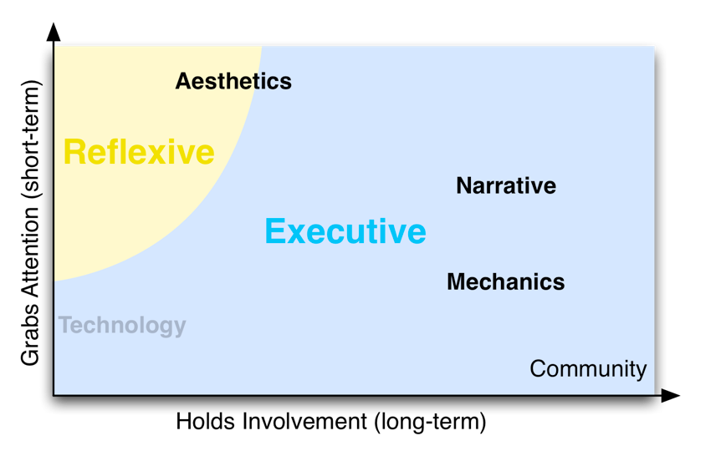
Player-Centric Goals: Attention and Involvement
The four elements in relation to Attention and Involvement
‹#›

Slide 25
Player-Centric Goals: Attention and Involvement
Narrative and Mechanics both require executive attention
Narrative has a greater ability to grab our attention
Both Narrative and Mechanics can sustain it for 100 hours
But Narrative must constantly be evolving and developing
Mechanics can stay the same and still keep someone involved
Community can outlast both Narrative and Mechanics in terms of involvement
Community kept many guilds together in Ultima Online long after most people had moved on to other games
When the members of the communities did eventually move on, they chose as a community which new game to play
Continuing the same community through multiple different games
‹#›

Slide 26
Player-Centric Goals: Interesting Decisions
Sid Meier states that "Games are a series of interesting decisions"
Six aspects of making a decision interesting:
Discernible
Integrated
Ambiguous
Double-edged
Novel
Clear
‹#›

Slide 27
Player-Centric Goals: Interesting Decisions
Discernible - From Rules of Play by Salen and Zimmerman
The player must be able to tell that the game received and understood her decision
Immediate feedback
Integrated - From Rules of Play by Salen and Zimmerman
The player must believe that her decision will have some effect on the long-term outcome of the game
Long-term impact
Ambiguous - From Game Design Theory by Keith Burgun
A player can guess how the decision will affect the system
But she can never be sure
‹#›

Slide 28
Player-Centric Goals: Interesting Decisions
Double-edged
The decision has both an anticipated upside and downside
Novel
The decision is sufficiently different from other decisions that the player has made recently
Example: Combat in Grandia III has many more novel decisions than that in Final Fantasy VII
In Grandia III, position matters in combat, and both the player's party and enemies are constantly moving to new locations on the battlefield
These new locations cause each decision to be more novel
‹#›

Slide 29
Player-Centric Goals: Interesting Decisions
Clear
Ambiguity in the outcome of the choice is important
But the choice itself must be clear
There are many ways a choice can lack clarity:
Too Many Options – There are too many options to choose from at a given time
The player can have difficulty discerning the differences between them
This is called choice paralysis.
Unclear Outcome – If the player can't guess what the outcome of the choice might be, it is too unclear
This was often an issue with dialog options in RPGs
Mass Effect solved the lack of clarity in dialog options
The Significance of the Choice is Unclear – If a choice is critical to the game or the character, the player needs to be aware of this
In Grandia III, the player is warned if it is her last chance to prevent a massive attack from hitting one of her characters
‹#›

Slide 30
Player-Centric Goals: Interesting Decisions
The six aspects of making a decision interesting:
Discernible
Integrated
Ambiguous
Double-edged
Novel
Clear
By making your decisions more interesting, you can
Increase the appeal of your mechanics
Increasing the player's long term involvement in your game
‹#›

Slide 31

Player-Centric Goals: Experiential Understanding
The desire for players to understand something complex by experiencing it themselves
Mainichi by Mattie Brice (2013)
‹#›

Slide 32
Player-Centric Goals: Experiential Understanding
Mainichi is a personal letter from Brice to a friend to help her friend understand what her daily life is like
In her real life, Brice is a transgender woman living in the Castro district of San Francisco
In Mainichi, the player takes on the role of Mattie Brice and must choose what to do to prepare to go out for coffee with a friend:
Does she dress nicely, put on makeup, eat a bite?
Each of these decisions change how some (but not all) of the people around town react to her
A simple decision like whether to pay with a credit card or cash has meaning in the game
Paying with a credit card will cause the barista to refer to you as "Ms… er… Mr. Brice" because he reads Brice's old, male name on the credit card.
‹#›

Slide 33
Player-Centric Goals: Experiential Understanding
Players' decisions change how Mattie is perceived
Therefore players feel complicit in her being treated well or poorly by the people around her
At this time, only interactive media can convey this sense of responsibility to the audience
Experiential understanding is one of the most interesting goals that we can seek to achieve as game designers
‹#›

Slide 34
Chapter 8 – Summary
Every game developer has different feelings about each of these reasons
Some people just want to make fun experiences
Some people want to give players interesting puzzles
Some people want to encourage players to think deeply about a specific topic
Some people want to give players an arena in which to be empowered
You can choose which reasons are important to you
Next Chapter:
Regardless of what your reasons are for wanting to make a game, it is time now to start making them!
The next chapter is about Game Prototyping
‹#›

